Slide 1


A Robot Task Planner that Merges Symbolic and Geometric Reasoning
Elective in Artificial Intelligence
Reasoning Agents
Prof. Fabio Patrizi
Leandro Maglianella - 1792507

Slide 2
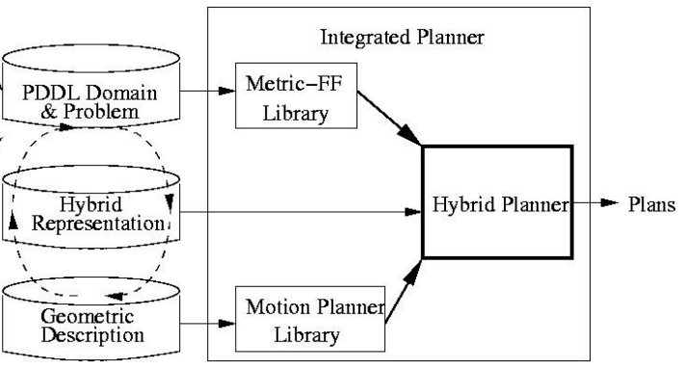
Paper Content
This paper is about aSyMov, a planner designed to address intricate robot planning problems where geometric constraints are relevant and influence the symbolic plan.
The proposed implementation of aSyMov is tested on an illustrative example.

Slide 3
Problem Description

Slide 4
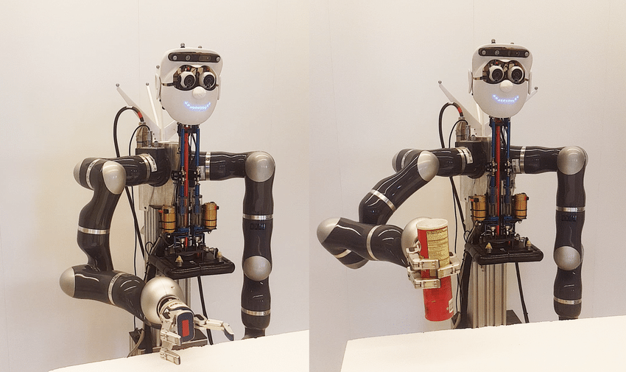
Problem Description
Often planners lack of effectiveness in robotics task because there is a gap between the representation they are based on and the physical world.
At each step of the planning process both symbolic and geometric constraints must be considered.

Slide 5
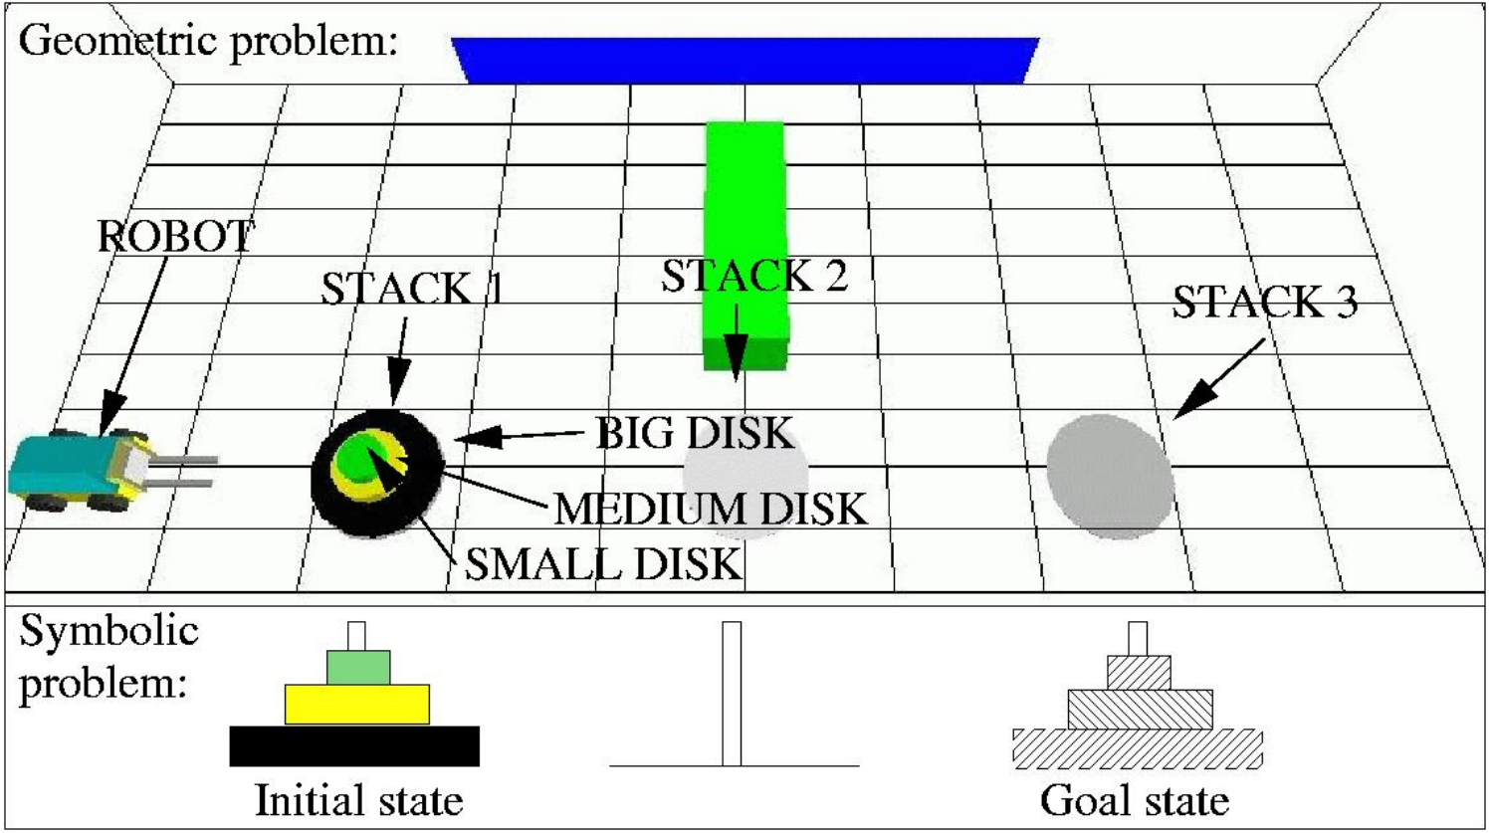
Problem Description
The authors create an example based on the Hanoi Tower Problem.
“Classical” Hanoi Tower Problem

Slide 6
Problem Description
“Geometric Hanoi Tower Problem with 3 disks” (GHTP-3)
Disks are moved by a non-holonomic robotized fork-lift.

Slide 7
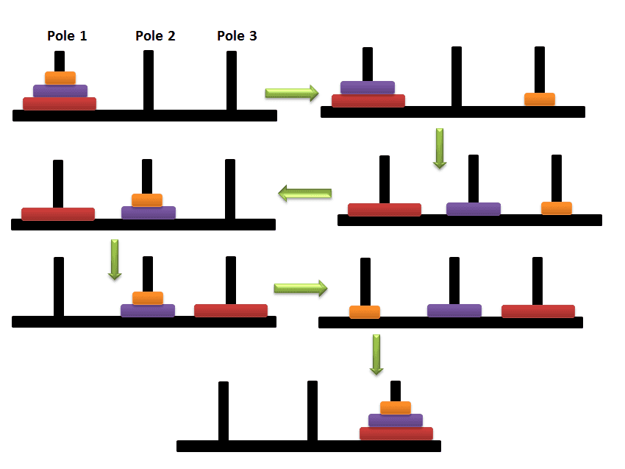
Problem Description
A good symbolic planner would be able to find the optimal solution:
BUT this solution is actually not achievable in our case because the environment is also geometrically constrained.

Slide 8
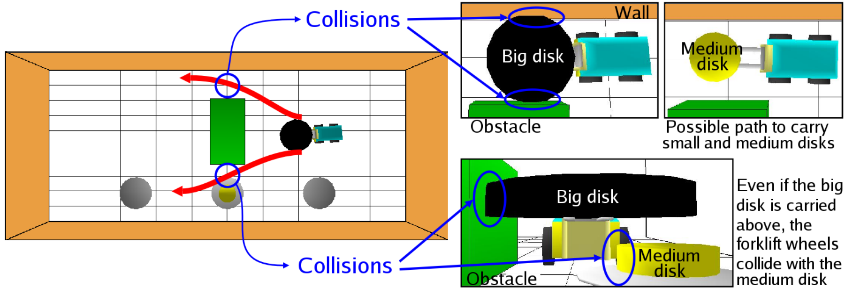
Problem Description
All possible robot motions depend not only on the static environment but on the context (robot and objects positions).
Each context may possibly create a different free-space topology and consequently create specific constraints on robot motions.

Slide 9
Implementation

Slide 10
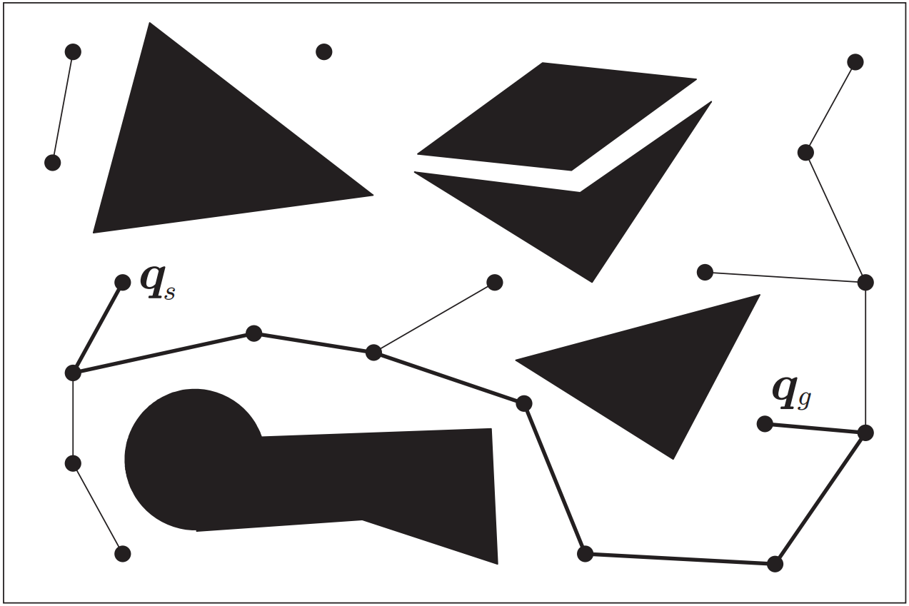
Geometric Reasoning
Environment: 3D-world with static and dynamic components.
Roadmap: The motion planner uses a Probabilistic Roadmap method.
In the constructed graph, a node represents a collision-free configuration and the edges are valid robot motions.

Slide 11
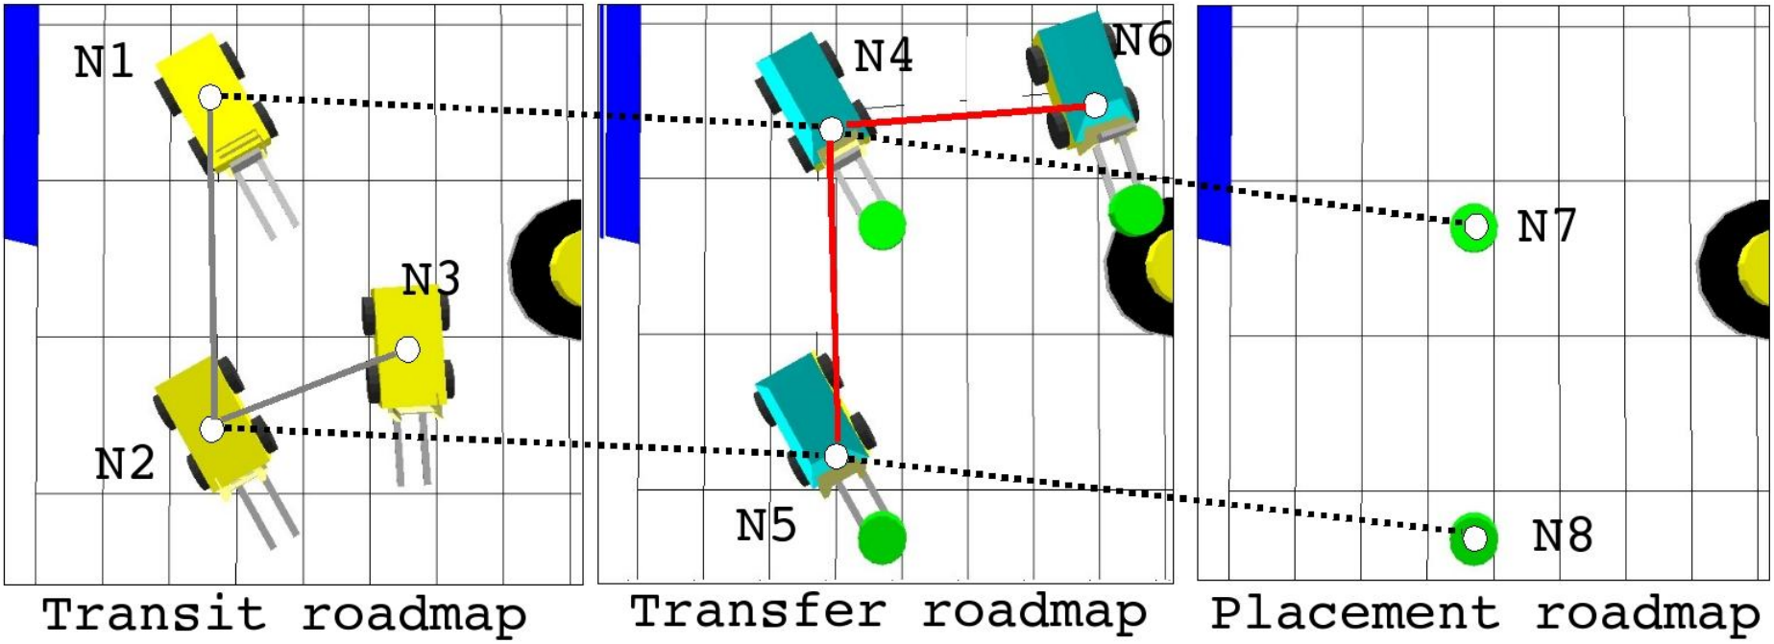
Geometric Reasoning
Transit / Transfer / Placement:
A solution to a manipulation problem is a sequence of transit and transfer motions.
The transit motion of the robot between two grasping positions.
The transfer motion of the robot with a taken object.
The set of all stable object positions is called placement.

Slide 12
Symbolic Reasoning
A symbolic position
A subset of the configuration nodes of one roadmap that satisfy a given property.
P_{robot name}_{roadmap name}_{property}
P_R_TI_TA_O: the configurations where a robot R can grasp an object O.
In the figure = {N1, N2}.
P_R-O_TA_TI: the configurations where a robot R can drop an object O.
In the figure = {N4, N5}.
P_R_TI_RELOAD_BATTERY: the configurations where a robot R can apply a RELOAD_BATTERY action.

Slide 13
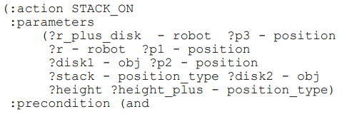
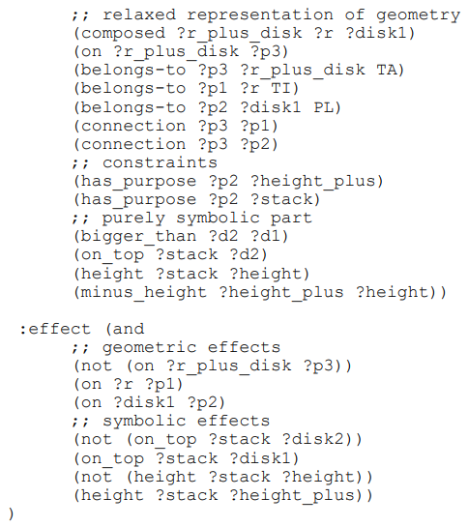
Symbolic Reasoning
The authors chose to use PDDL 2.1 to specify the described symbolic representation.
Basic predicate set:
(composed ?r1 ?r2 ?r3)
(belongs-to ?p ?r ?roadmap-type)
(has-purpose ?p ?pos-type)
(connection ?p1 ?p2)
(on ?r ?p)
Basic action set:
(goto ?r ?p1 ?p2)
(grasp ?r ?p1 ?o ?p2 ?new-r ?p3)
(release ?old-r ?p1 ?o ?p2 ?r ?p3)
(switch-motion ?r ?p1 ?p2)

Slide 14
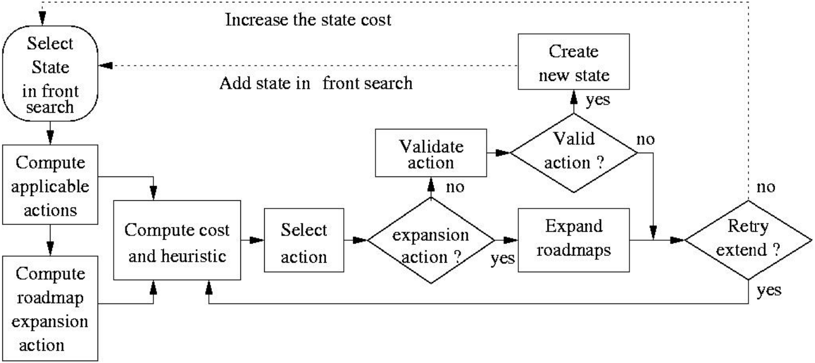
Algorithms and Strategies
Extend state algorithm

Slide 15
Experiments

Slide 16
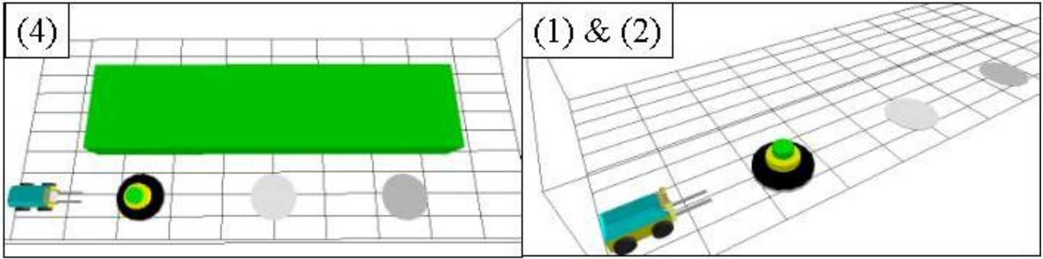
Experimental Instances and Results
(3)
 | CPU time | Nb step | Connectivities | Plan length
(1) | 0.266 | 38.5 | 17.5 | 28
(2) | 9.97 | 63.7 | 25.4 | 28.8
(3) | 271.6 | 243.8 | 71.2 | 44
(4) | 298.9 | 213.6 | 62.8 | 40.16

Slide 17
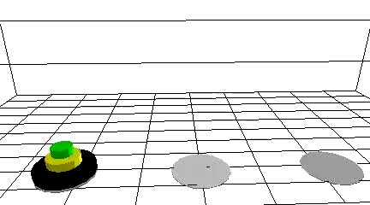
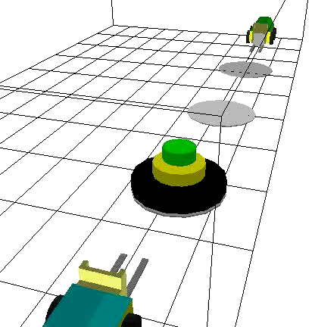
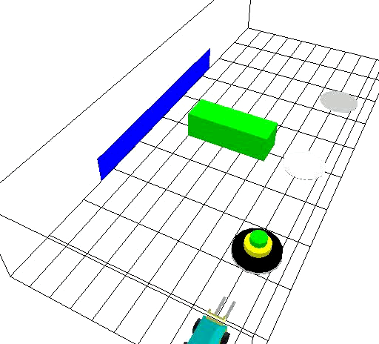
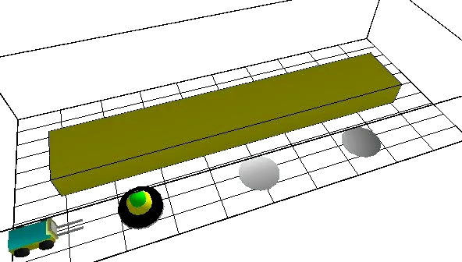
Experimental Instances and Results

Slide 18
Final Personal Comment

Slide 19
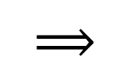
Final Personal Comment
Remarkable research and results, especially being it from 2004.
Generated plans take into account the geometric consequences of robots’ actions.
Plans have a better chance to be valid in the real world.
$$⟹$$
We intend to make a project about a robot that act as a teacher, therefore not colliding with children while moving an object is a plus.

Slide 20
References
Stephane Cambon, Fabien Gravot and Rachid Alami
"A Robot Task Planner that Merges Symbolic and Geometric Reasoning", 2004
Proceedings of the 16th Eureopean Conference on Artificial Intelligence, ECAI'2004

Slide 21
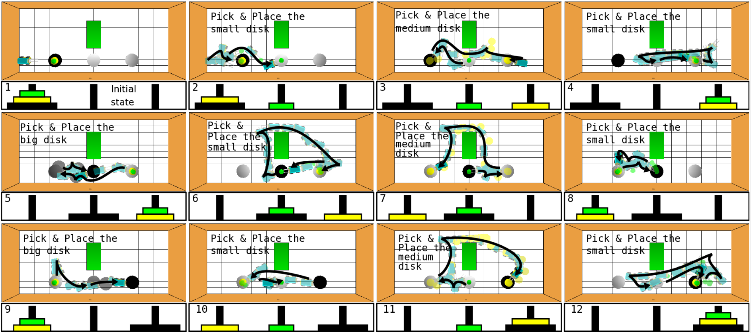
Appendix

